Slide 1
Integrating industry and other ‘real world’ learning experiences within the real estate curricula: Challenges and experiences
IRES Education Panel
ERES Conference 2010

Slide 2
Challenges
Small property market
Hit by the GFC
Make sure that we are the no. 1 choice for Property Graduates
Keep up relationships with industry
Keep course relevant and up to date

Slide 3
Enhancing Graduate Employability
At the University of Auckland Business School we have a comprehensive and structured approach to enhancing our graduate employability, these include:
Director of Careers
Board of Advisors
Career Development programmes
Buddy/Coffee Mate Programmes
Alumni Evenings
Networking Evenings
Property Case Competitions
Job placements - Graduate profile book

Slide 4
Business School Careers Centre
James Hairsine is currently the Director of Careers at the University of Auckland Business School.
He runs the Business School’s Careers Centre which helps provides students with a world-class career management support service
The Department of Property works closely with him to enhance it’s own offerings

Slide 5
Advisory Board
The Advisory Board is made up of senior property professionals representing different sectors of the industry.
The main objective is to produce world-class graduates, research and ideas that underpin the industry’s position within a knowledge-based economy and society.
Company representation include:
Jones Lang LaSalle
Colliers International
CBRichard Ellis
Bayleys
ING (NZ) Ltd
Goodman Property Trust
Knight Coldicutt Lawyers and Barristers
Darroch Valuations
Brookfield Multiplex

Slide 6
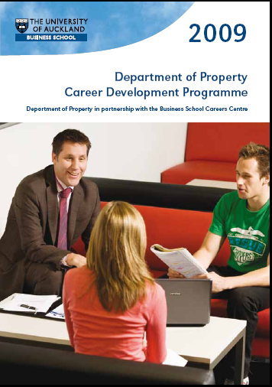
Enhancing Graduate Employability
Career development programme includes:
Skills audit
Writing a winning CV
Creating an impression at an interview
Working effectively in a team

Slide 7
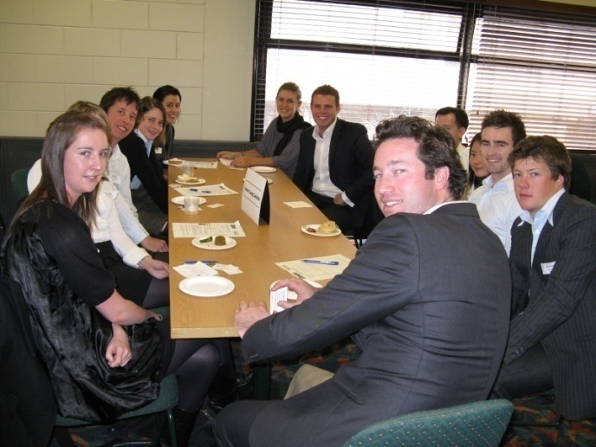
Enhancing Graduate Employability
The Real Estate Institute of New Zealand (REINZ) Buddy Programme
A programme designed to assist Property students to meet with real estate professionals to gain “real life” insights. Offered in the 2nd year of their BProp.
Sponsored by REINZ

Slide 8
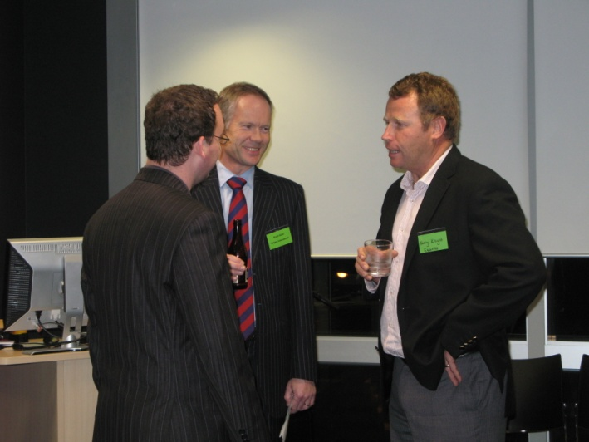
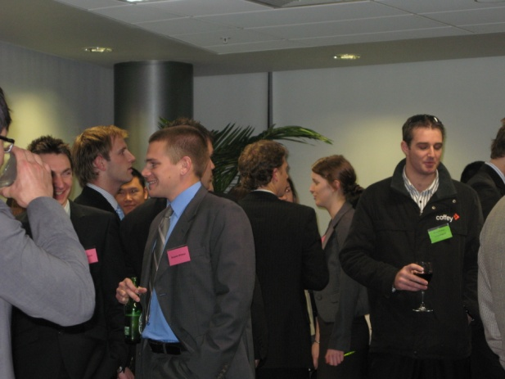
Enhancing Graduate Employability
The Property Institute of New Zealand (PINZ) Coffee Mate Buddy Programme and Speed Networking evening
An invaluable learning experience for future property professionals offered to final year students. It is designed to assist final year students in making informed career choices and develop a relationship with a mentor in the industry.
Students get a chance to partake at a speed networking function and then have a
“coffee interview” with
professionals in the
community.
Often ends up with offers
of employment

Slide 9
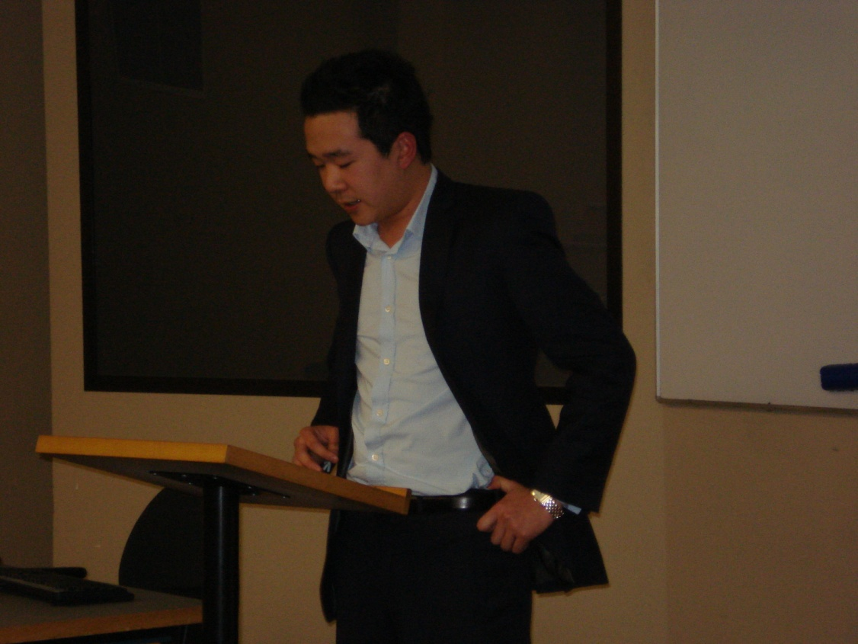
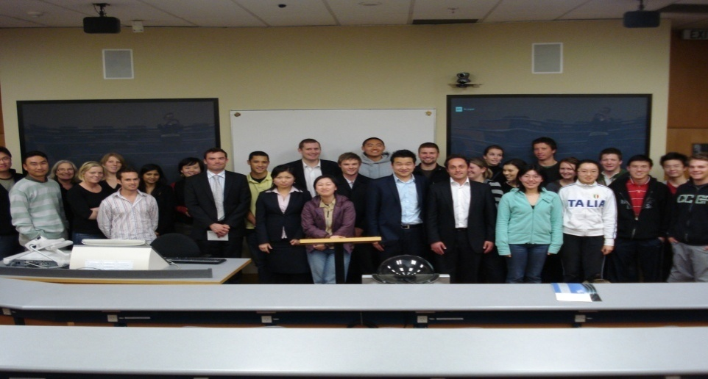
Enhancing Graduate Employability
Alumni Evening
Life After the BProp
Students get the opportunity to hear from and network with recent graduates in order to get insights into the graduate experience in disparate parts of the Property Industry.
This session also includes a presentation from employers of BProp students and graduates.

Slide 10
Enhancing Graduate Employability
Networking Evenings
Companies invite students to a function at their offices, thus giving students an opportunity to mix and mingle with staff from these offices. Current participants:
Bayleys
Colliers International
CBRichard Ellis
Jones Lang LaSalle

Slide 11
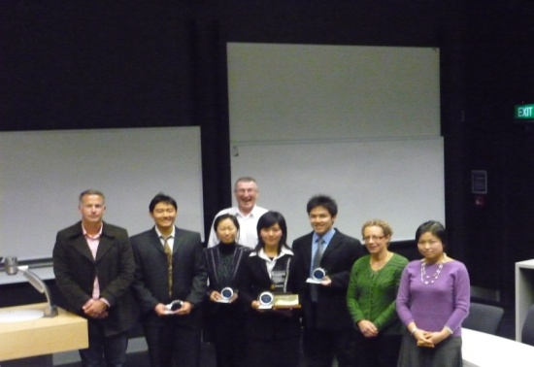
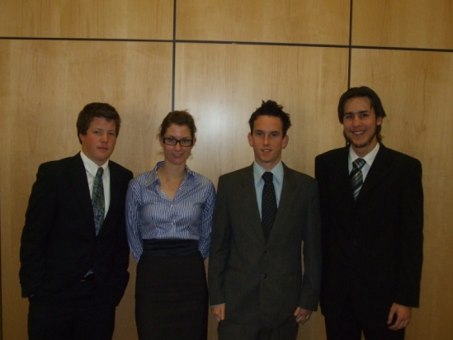
Enhancing Graduate Employability
Encourage participation in Property Case Competitions
Teams are provided with information about a company and are given time to analyse the case, develop a solution and prepare, present and defend it to a panel of business practitioners.
Helps develop essential skills for employment such as communication, presentation and teamwork.
Internal competition, PRRES competition (2010 winners) and University of Southern California competition which runs over 3 days.

Slide 12
Enhancing Graduate Employability
Graduate Profiles Brochure distributed to all aluni and industry

Slide 13
Enhancing Graduate Employability
Scholarships
Especially those that require interviews
To name a few…………
Blair Hargrave/Colliers International Scholarship
Goodman Scholarship
Keystone Bayleys Property Scholarship
Alexander Dorrington Scholarship
Here students get a chance to impress in front of potential employers often ends up with employment offers

Slide 14
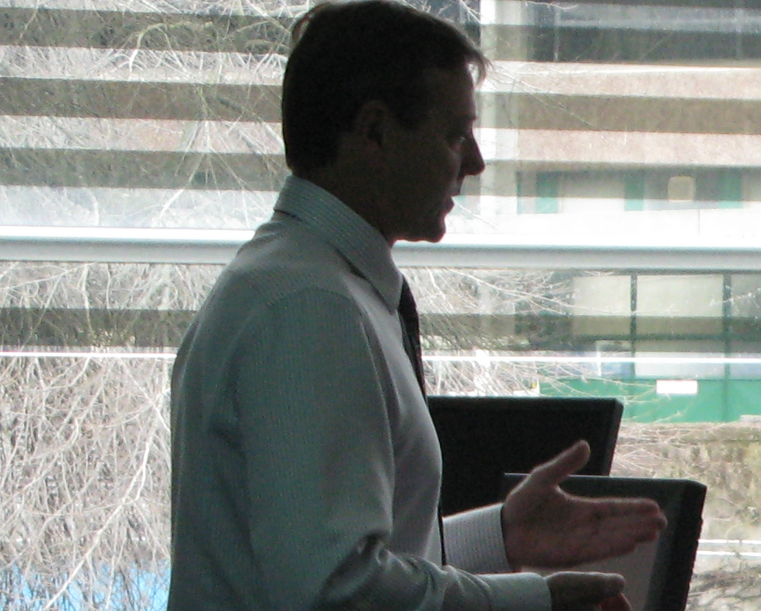
Raising Commercial Awareness and Curriculum Inputs
Teaching/seminars
Contract staff teaching key practical subject areas
Visiting lecturers from academia and industry
Case study/assignment material
Mentoring
Advisory Board
Property seminar includes academic and industry speakers.

Slide 15
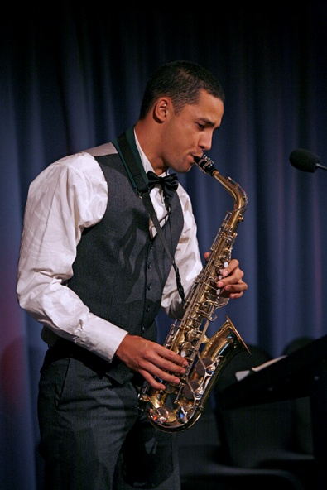
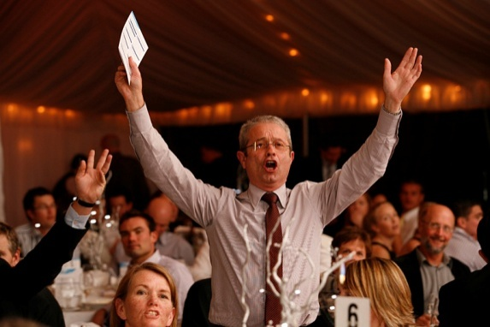
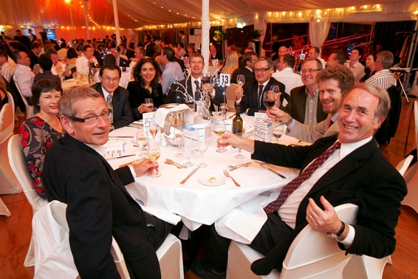
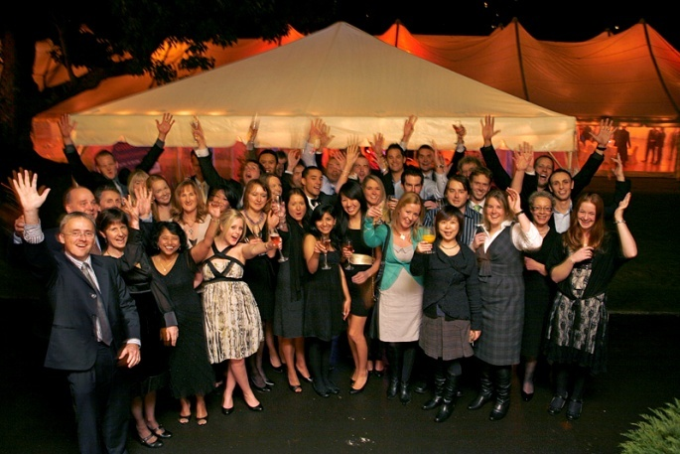
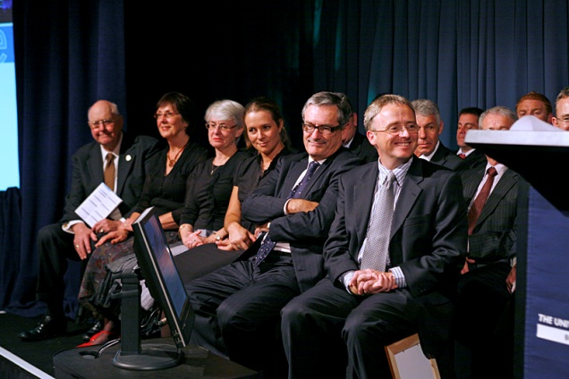
Keeping up close relationships with Industry
Property Dinner
Celebrate the property profession in New Zealand and pay tribute to our graduates and scholarship and award winners.
Dinner sponsorship
Auction
Scholarships

Slide 16
Accreditation
The Bachelor of Property is recognised by:
The Royal Institution of Chartered
Surveyors (RICS) (UK)
The Property Institute of New Zealand PINZ)
The Valuers Registration Board (VRB)
The Real Estate Institute of New Zealand (REINZ)

