Slide 1
Public real estate economy as factor of local development within the parishes of the Małopolska Province (in the south of Poland) ERES 2010, Milano

Slide 2
Pillars of the presentation structure
Background to the study & objectives
Research methodology & data used
Results of empirical research
Conclusions & implications

Slide 3
Background to the study
Introduction
Public real estate economy (REE)
A wide approach to "real estate economy" of the local governments can be defined as conscious and purposeful actions, in accordance with the law. It encompasses making decisions and undertaking factual and legal acts related to the real estates located within the parish and aiming at specific targets which are subject to local development policy.
Local development (LED)
–
socio-economic development within the Parishes

Slide 4
Objectives
PhD Framework
The main aim:
Investigating the relations between widely understood real estate economy (REE) and social-economic development (LED) within the Małopolska Province parishes.
The detailed aims:
Level of diversity in respect of LED and REE
Statistical interdependence between LED and REE
Use of REE instruments

Slide 5
Poland

Slide 6
Małopolska Province
One of sixteen provinces (regions) in Poland.
Located in the south of Poland and covers the area of 15 190km2.
57 cities in this territory, including three with district rights, such as Kraków, Tarnów and Nowy Sącz.
The territory divided into 22 districts, which in turn are divided into parishes. (in total divided into 182 parishes)
Inhabited by ca. 3 300 000 people (ca. 9% of population in Poland)
The number of student makes Malopolska the second region in Poland.
Public administration in Poland
central
province
district
parish

Slide 7
Research methodology & data used
The first part of the research is based on statistical public data gathered by the Central Statistical Office in Poland (GUS). It consists of the statistic evaluation (by means of taxonomic analysis method) of the LED level and the REE in the Małopolska Province parishes.
Taxonomy-model analysis Statistic verification of diagnostic variables Standardization of variables nature Normalization of variables Construction of a synthetic measure
Z1 - aggregate measure for the level of socio-economic development (LED) | Z2 - aggregate measure for the structure of real estate economics (REE)
partial synthetic measures Demographic potential Living conditions Economic development | partial synthetic measures Public land management Public housing stock management Local planning
22 indicators | 9 indicators

Slide 11
Research methodology & data used
PhD methodology
Instrumental approach to the real estate economy.
The aim of this stage was identifying and assessing the use of REE instruments for the purposes of the LED in the Małopolska Province parishes.
The questionaire sent to 182 parishes of the Province. The response level slightly exceeded 50%.
Analytical process conducted in accordance with division the parishes into two groups with regards to the value of the synthetic variable of the LED calculated on the basis of taxonomic analysis:
a group of well-developed parishes and
a group of underdeveloped parishes.

Slide 12
Results of empirical research
PhD analysis stages

Slide 13
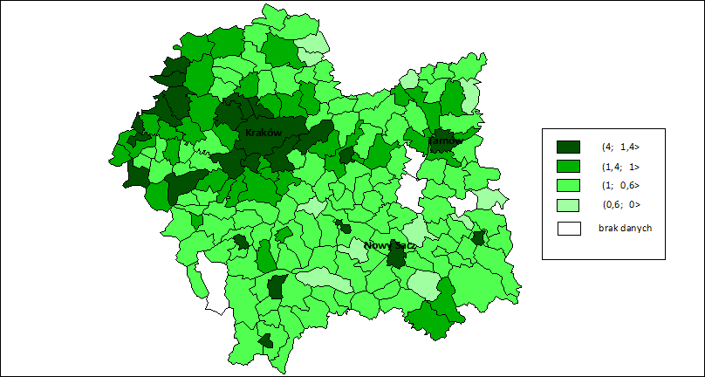
Spatial differentiation of Małopolska Province parishes according to the value of a synthetic variable
PhD outcome
Source: own study

Slide 14
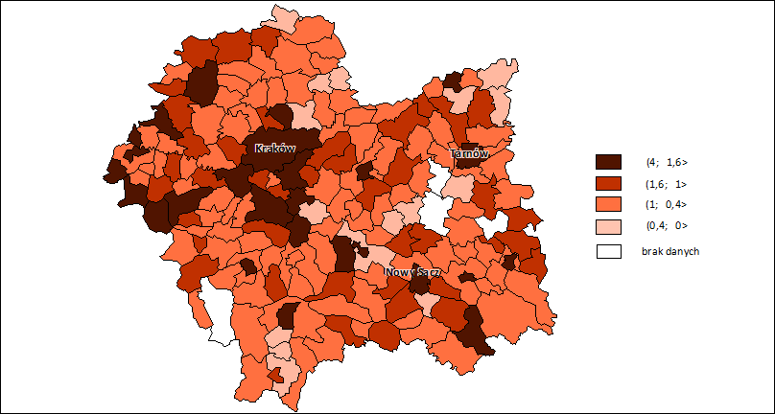
Spatial differentiation of Małopolska Province parishes according to the value of a synthetic variable
PhD outcome
Source: own study

Slide 15
Correlation matrix between synthetic, partial and aggregate variables
PhD outcome

Slide 16
The potential instruments of real estate economy I asked about in the survey
PhD survey
A | preparation of location offers for investors,
B | local authority support for an investor in the process of granting construction permit,
C | local authority support for an investor in the process of negotiation with the owners of real estate to get land for investments,
D | preparation of land for investments by means of conversion – reclassification, combining and dividing,
E | adopting plans of spatial development which are actual and convenient for investors,
F | application of lower property tax rates that statutory rates,
G | differentiation of property tax rates due to the character of business, location of the real property and type of construction,
H | using property tax reliefs and tax exemptions in relation to the character of business or investment activity,
I | development of infrastructure in the investment area for private entities,
J | investing into development and appropriate maintenance of local road connections,
K | purchasing land by the parish from private owners in order to prepare and provide the land to investors,
L | temporary provision of buildings and parish premises on a lease/rental basis to conduct business activities,
M | application of preferential rental rates for parish real property in order to conduct business activities,

Slide 17
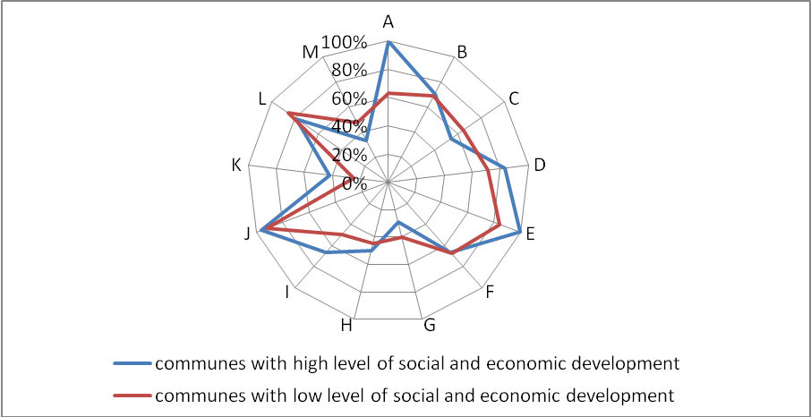
The use of the real estate economy instruments by the local authorities
PhD outcome
Source: own study

Slide 18
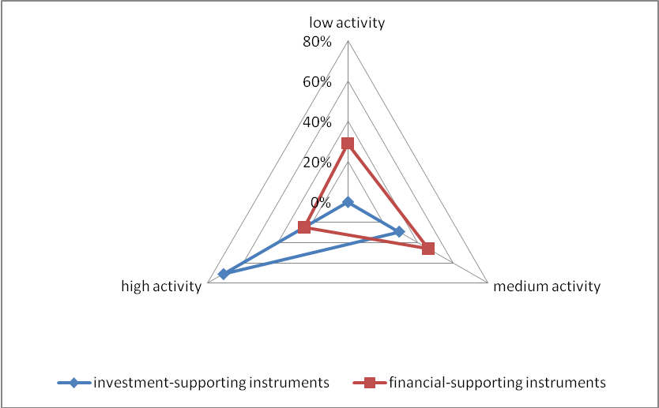
Index of the usage of real estate economy instruments in the parishes with high level of social-economic development
PhD outcome
Source: own study

Slide 19
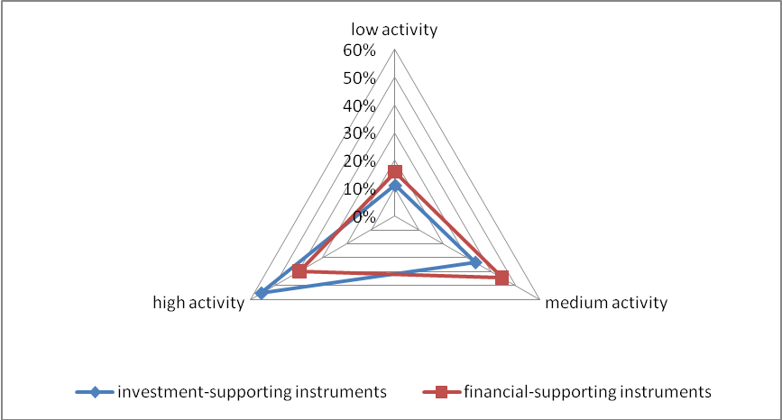
Index of the usage of real estate economy instruments in the parishes with low level of social-economic development
PhD outcome
Source: own study

Slide 20
Conclusions
Verification of hypotheses
Significant spatial diversity due to partial and synthetic variables which describe LED and REE,
Significant positive correlation between LED level of the parishes and the condition of REE. Due to the complexity of the analysed phenomena as well as their mutual co-influence there is not possible to indicate the simple cause and effect relation between LED and REE.
The proper choice of REE instruments leverages the level of LED in parishes

Slide 21
Implication
Verification of hypotheses
Local authorities contribute to parish development by:
simplifyng and facilitating the investment process which investors have to go through,
increasing the investment value of lands within the parish,
creating public land available for public use or investments,
implementing comprehensive and long-term investor supporting programs.
Financial support instruments in the form of reliefs and exemptions of real estate charges should not be widely used.
Possible use of financial support instruments should be directed to defined business entities, the selection of which, is based on narrow criteria.
Using the instruments of real estate economy should be subordinated to strategic objectives of social and economic development and executed in a form of comprehensive and long-term actions.

Slide 22
Questions and comments

Slide 23
Thank you
Contact details:
Agnieszka Małkowska
Univeristy of Economics
Katedra Ekonomiki Nieruchomości i Procesu Inwestycyjnego
ul. Rakowicka 27,
31-510 Kraków
POLAND
Phone: +(48) 12–293-55-93,
Email: malkowsa@uek.krakow.pl

