Slide 1
Precisely Wrong or Roughly Right? An Evaluation of Development Viability
Peter Byrne
Pat McAllister
Peter Wyatt
www.henley.reading.ac.uk/rep/fulltxt/0810.pdf

Slide 2
Structure
Main Research questions
Background and context
Current practice
Uncertainty issues
Some hypothetically typical developments and their simulation outputs
Findings and conclusions

Slide 3
Main research questions
Given intrinsic input uncertainty and volatility, what do:
choice of model structure, and
level of input variable complexity
mean for the uncertainty of DVA output(s)?

Slide 4
Background and context
Financial modelling of development proposals has now become a matter of public policy
DVAs are a central component of negotiations on planning contributions
Developers and planning authorities must now demonstrate that proposals are financially viable
Development appraisal methodology is increasingly being scrutinised and contested

Slide 5
DVAs: current practice
DVAs are rule-based, deterministic models that attempt to simulate the expected input-output behaviour of a development project
Specifically regarding quantity and timing of future revenue and expenditure
Like all models, they simplify – to varying degrees...

Slide 6
DVAs: current practice
Well-known limitations of traditional residual approach linked to assumptions about
Timing of expenditure and receipts
Simplistic profit ‘mark-up’
Inclusion of finance costs
Lack of forecasts
Cash flow models have ‘solved’ the timing and forecast issues only
An alternative cash flow approach has been proposed – but requires a hurdle rate of return to be specified

Slide 7
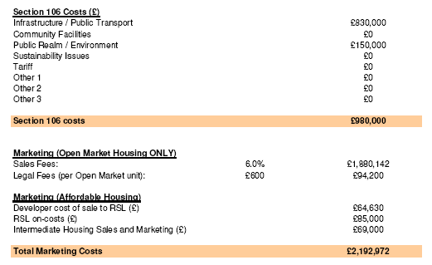

Slide 8
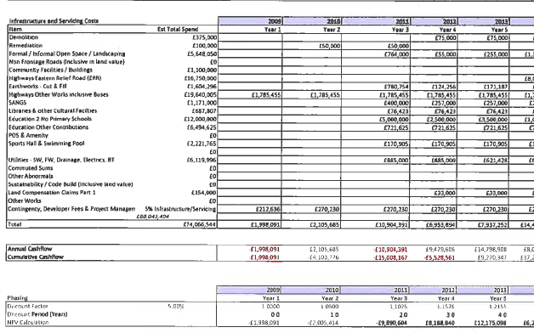

Slide 9
Uncertainty issues
Model structure
Choice of model scale: extent and balance of disaggregation
Error propagation
Inputs
Over-parameterisation vs. parsimony
Uncertain estimation and uncertain volatility
Most are stochastic rather than deterministic
Many are linked in a ratio-dependent manner
Some of these ratios are also stochastic

Slide 10
Is there an optimally complex model?
Output uncertainty
Model uncertainty
Output uncertainty due to model uncertainty
Input uncertainty
Output uncertainty due to input uncertainty
Optimal level of
model complexity
Model Complexity

Slide 11
Monte Carlo Simulation is used to assess whether
Choice of model structure produces significantly different output means and variance?
Choice of model scale produces different output means and variances?
Five models
Traditional residual model
Aggregated standard cash flow model
Aggregated alternative cash flow model
Disaggregated standard cash flow model
Disaggregated alternative cash flow model

Slide 12
Key assumptions and inputs #1

Slide 13
Results - #1

Slide 14
Key assumptions and inputs #2

Slide 15
Key assumptions and inputs #2

Slide 16
Results #2

Slide 17
Results #2

Slide 18
Conclusions and Further Work
DVAs are now an important nexus in the UK planning system.
Many of the dilemmas in development viability modelling are shared in other disciplines.
Largely due to high levels of input uncertainty, it is a common finding that simple, aggregated models can display equifinality with complex, disaggregated models.
We also find evidence of equifinality in the outputs of a simple, aggregated model relative to more complex, disaggregated models.
However, we need further testing to model phased developments and development period uncertainty.
We need to be more certain that our conclusions are robust and are not a function of subjective estimates of estimated variances, distributions and correlations.

