Slide 1
‘Real Estate, Governance, and the Global Economic Crisis’
Piet Eichholtz
Maastricht University
Nils Kok
UC Berkeley
Maastricht University
Erkan Yönder
Maastricht University
ERES 2010 Conference
June 2010

Slide 2
The crisis originated in the real estate sector …and is mostly a governance crisis
Securitized products, such as MBS, CMBS and CDOs
Intransparency
No accurate pricing data
No proxies for governance quality
Listed property companies (REITs)
A laboratory environment
Represent the crisis

Slide 3
Governance in REITs Strong institutional setting
REITs are tax-exempt…
…but this leads to increased rules and regulations
90% payout rule
75% income out of real estate or real-estate related assets
5-50 rule, at least 100 shareholders
This strong legal setting reduces agency problems, which may mitigate the need for corporate governance.
(Klapper and Love, 2004, La Porta et al., 2000)
(Bauer, Eichholtz, and Kok, 2010)
Managers may become more entrenched during the crisis.
Institutional ownership positively affected returns during the Asian crisis.
(Mitton, 2002)
Notes:
What do we know about governance issues in listed property companies – REITs?

Slide 4
Trends in Market and Real Estate Indices …a deeper crisis for REITs
Notes:
The cumulative return to the NAREIT Equity index corresponds to 191 percent from January 2003 through January 2007, the top observation in the NAREIT index, while it lost 68 percent from January 2007 through February 2009. In the same time period, the S&P 500 index increased by 68 percent and then decreased by 49 percent.

Slide 5
The role of governance… Positive or neutral effects?
Main research questions in this paper:
The role of corporate governance on stock performance during the boom and the crisis
Portfolio study
Cross-sectional analysis
How influential is the ownership structure during the crisis?

Slide 6
Data – governance proxy Risk Metrics data widely used in industry
Corporate Governance Quotient Index (CGQ) provided by Risk Metrics
CGQ index is aggregation of 61 issues, covering 4 categories
1) Board of directors
2) Audit
3) Anti-takeover provisions
4) Executive and director compensation
Sample
112 – 139 REITs
77 months, from January 2003 through May 2009
Notes:
How to measure the strength of corporate governance in property companies? Subject to debate, but one of the proxies is CGQ of Risk Metrics.

Slide 7
Portfolio analysis, good vs bad governed The effect of governance on performance

Slide 8
Abnormal returns… …influence of corporate governance
The model:
(1)
where,
SMB = the monthly return on a small minus big factor portfolio in month t
HML = the monthly return on a high minus low book-to-price portfolio in month t
MOM = the monthly return on a past months’ winners minus past months’ losers portfolio in month t
(2)
where,
G = a vector of annual average governance scores of equity REIT i
Debtratio = the annual average leverage of equity REIT i
FFO = funds from operations of equity REIT i
R
=
α
+
β
(
R
−
R
)
+
β
(
SMB
)
+
β
(
HML
)
+
β
(
MOM
)
+
ε
ti
i
0
i
m
f
t
1
i
t
2
i
t
3
i
t
ti
α
=
δ
+
δ
G
+
δ
DEBTRATIO
+
δ
FFO
+
ϑ
i
0
1
i
2
i
3
i
i

Slide 9
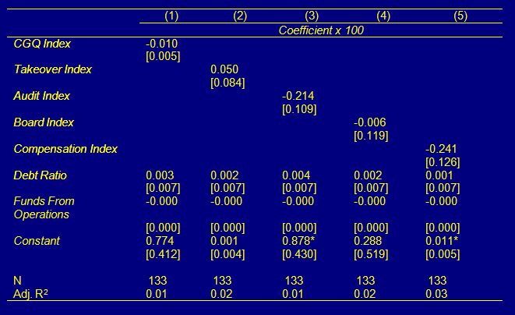
Results subperiod I: property boom Good governance does not affect returns...

Slide 10
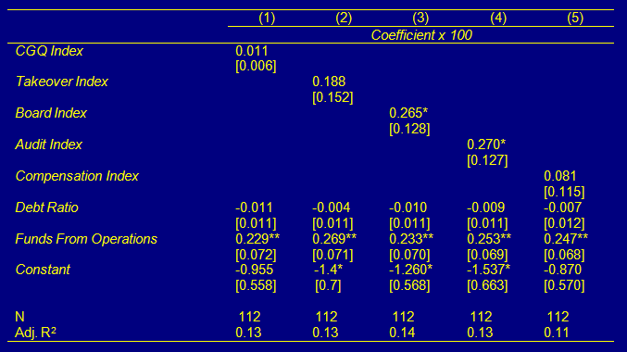
Results subperiod II: property bust Good governance now positively affects returns...

Slide 11
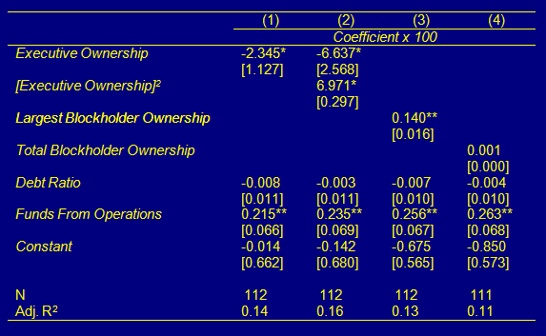
Results subperiod II: property bust Institutional ownership enhances performance…

Slide 12
Conclusions and implications Governance matters during crisis even in this strong legal setting…
“REIT Effect” holds during the boom.
Good Governance turns out to be important during the crisis.
Ceteris paribus, depreciation effect on the free cash flow
Managers are more likely to become entrenched during crises.
Investors ignored governance during the real estate frenzy.
Executive vs Institutional Ownership
Power effect of executive ownership dominates up to a threshold.
Beyond that threshold, benefits from stock ownership dominates.
Large blockholder contributes to performance.

