Slide 1
THE INCIDENCE OF COMPENSATIVE COSTS FOR PUBLIC STANDARD SERVICES
the case of Turin
Authors:
prof. Riccardo ROSCELLI
arch. Luisa INGARAMO
arch. Stefania SABATINO

Slide 2
KEY POINTS
THE BACKGROUND:
PUBLIC AND PRIVATE OBJECTIVES IN URBAN TRANSFORMATION PROCESSES
A CHANGE IN THE PUBLIC STANDARD SERVICES ASSESSMENT
THE 100% MARKET VALUE TO BE PAIED BY DEVELOPERS FOR STANDARDS
THE MAIN EFFECTS IN THE CURRENT FINANCIAL CRISIS
THE SOLUTION PROPOSED BY THE TURIN CITY
THE STANDARD AREAS PRICE NEGOTIATION
THE POLYTHECNIC OF TURIN: AN OPERATIONAL CONTRIBUTION METHODOLOGY PROPOSED AND TESTING PROCEDURES
MAIN RESULTS
THE INCIDENCE OF COMPENSATIVE COSTS OF PUBLIC STANDARD SERVICES ON THE PRIVATE DISCOUNTED CASH FLOW ANALYSIS
CONCLUSIONS …and latest news

Slide 3
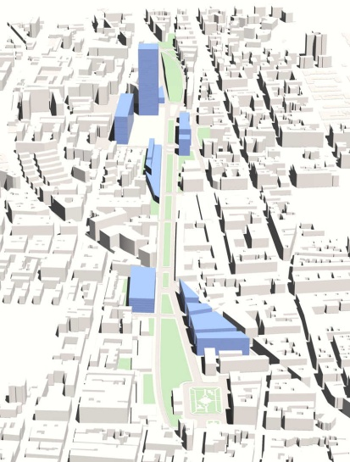
THE BACKGROUND
In Italy the different requirements and targets expressed by the stakeholders involved in urban transformations are commonly defined by law through “top-down” planning tools.
PUBLIC BODY
Turin City
National Jurisdiction (from ‘60-’70): private subjects sign up the area requested for public services to the City
standards
Private development
Public services supply
PRIVATE INVESTORS
Real Estate Developers
Green areas, parkings,…

Slide 4
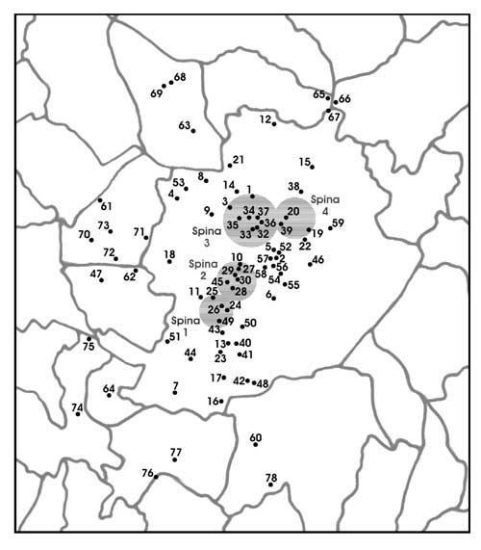
THE BACKGROUND
Areas to be transformed in consolidated or central locations of Turin
In recent years the city of Turin has developed many areas of transformation.
In any redevelopment site a minimum standard for public services has to be provided (25 sqm/inhabitant )
Many of the transformation sites are in consolidated or central locations.
By way of common knowledge, central locations have many binds (geometry, disposition, dimention…)
Source: Turin City website

Slide 5
THE BACKGROUND
LOCAL GOVERNMENT
(TURIN CITY PLAN – ART. 6)
If the site (> 4.000 sqm) is not easily available to realize the necessary standards for public services, the private land owner hold the whole plot and has to pay a “compensative cost” to the City, equal to the expropriation allowance
EXPROPRIATION ALLOWANCE 1998
(NATIONAL JURISDICTION) before 2008
50% of the market value
standards
Private development
100% Private development
Expropriation allowance before 2008 (Compensative costs paied as 50% of the market value assessed to the area share to withold)

Slide 6
THE BACKGROUND
The inner logic of the “compensative cost” resides in a greater efficency of the public standard supply:
100% PUBLIC SUPPLY OF SERVICES IN AN ANOTHER AVAILABLE AREA
100%
Public Services
Residual area
Residual area
100% Private development
100% Private development
Residual resources

Slide 7
A CHANGE IN THE PUBLIC STANDARD SERVICES ASSESSMENT
EXPROPRIATION ALLOWANCE
(NATIONAL JURISDICTION) since 2008
100% of the market value
Since 2008 developers should be compelled to compensate the City (for the allocation of Public Services in another available area), paying the 100% market value of the withold land share.
standards
Private development
EXPROPRIATION ALLOWANCE
(NATIONAL JURISDICTION) before 2008
50% of the market value
100% Private development
Expropriation allowance since 2008 (Compensative costs paied as 100% of the market value assessed to the area share to withold)

Slide 8
A CHANGE IN THE PUBLIC STANDARD SERVICES ASSESSMENT
COMPENSATIVE COSTS AT 100% OF THE MARKET
VALUE
The new law, imposing a double price for Compensative Costs, doesn’t expresses anymore the reciprocal exchange of advantages and attractiveness, between private and public subjects.
In addition, during last few years, the well-known conflict of i interest existing between the local urban developers (the City and the Real Estate Investors) has been amplified:
THE INTERNATIONAL FINANCIAL CRISIS
U-turn in the Italian Real Estate markets
THE ECONOMIC PLANS AND PROJECTS FEASIBILITY TENDS TO BE EXTREMELY REDUCED
A lack in Buildable areas
Trust-feelings decreasing
Bank Rate down to 1%
A lack in local economic resources
IF PRIVATE DEVELOPERS RESTRAIN THEIR BUSINESS, THE LOCAL BODIES LOSE BOTH PHISICAL AND ECONOMIC RESOURCES
Decreasing Risk Inclination

Slide 9
THE SOLUTION PROPOSED BY THE TURIN CITY
The traditional TOP-DOWN planning activity has shown it’s limit.
A more satisfying tuning between PRIVATE and PUBLIC actors was requested
As the public planning activity aims to
OPTIMISE the PUBLIC UTILITY, in terms of TIME, COSTS, RESULTS
GRANT A BALANCED SUPPLY OF PUBLIC SERVICES (MEASURE AND QUALITY)
CONVEY the PRIVATE SECTOR RESOURCES on the URBAN RENEWAL PROCESSES
A POSSIBLE SOLUTION MAY BE FOUND OUT THROUGH THE DEVELOPMENT OF AN EXPERTISE BASED ON:
agreements
conventions
Notes:
How to manage

Slide 10
THE SOLUTION PROPOSED BY THE TURIN CITY
THE STANDARD AREAS PRICE NEGOTIATION: A POSSIBLE SOLUTION?
3
PRIVATE DEVELOPER
THE NEGOTIATION LEADS TO A CONTRACTUAL AGREEMENT
THE CITY SENTENCES A DISCRETION AROUND THE PROPOSAL ADEQUACY
1
2
GIVES AN EARLY OPINION ON THE FAIR VALUE TO PAY FOR THE LAND-SHARE TO BE COMPENSED
CITY

Slide 11
THE SOLUTION PROPOSED BY THE TURIN CITY
THE PRIVATE DEVELOPER PROPOSAL IS BASED ON:
THE LAND SHARE USEFUL FOR PUBLIC USES CAN BE COMPENSATED THROUGH A FAIR PRICE.
AS THE MARKET PRICE IS TOO HIGH…
“RATE OF RETURN” EXPECTATION
“RATE OF RETURN” EXPECTATION
COMPENSATIVE COSTS (AS ADDITIONAL CHARGE)
COMPENSATIVE COSTS (AS ADDITIONAL CHARGE)
?
EFFECTIVE COSTS OF THE PUBLIC STANDARD SERVICES
…THE CITY HERITAGE OFFICE NEEDED A SUPPORT IN DEFINING A PROPER METHODOLOGY USEFUL TO CHECK THE PRIVATE PROPOSAL FROM IT’S INNER POINT OF VIEW
PUBLIC BUDGET CONSTRAINS
THE CITY

Slide 12
THE POLYTHECNIC OF TURIN CONTRIBUTION
METHODOLOGY PROPOSED AND TESTING PROCEDURES
A PRE-FEASIBILITY METHODOLOGY →THE DISCAUNTED CASH-FLOW ANALYSIS
The economic-financial approach it’s used to simulate the whole development of the dynamic Real Estate process,
from the point of view of the private investor
“RATE OF RETURN” EXPECTATION
The analysis considers the compensative costs as an additional item and aims to find out a fair trasformation value of the witheld land share, to be paid back to the City. The processing fixs the ”rate of internal return” expected by the Developer.
“RATE OF RETURN” EXPECTATION
COMPENSATIVE COSTS (AS ADDITIONAL CHARGE)
COMPENSATIVE COSTS (AS ADDITIONAL CHARGE)
The DCF can be considered a proper tool to:
guide the City choices within the market mechanism
speed up the private and public agreements
take in consideration a fair compensation for the CiTY
EFFECTIVE COSTS OF THE PUBLIC STANDARD SERVICES
PUBLIC BUDGET CONSTRAINS

Slide 13
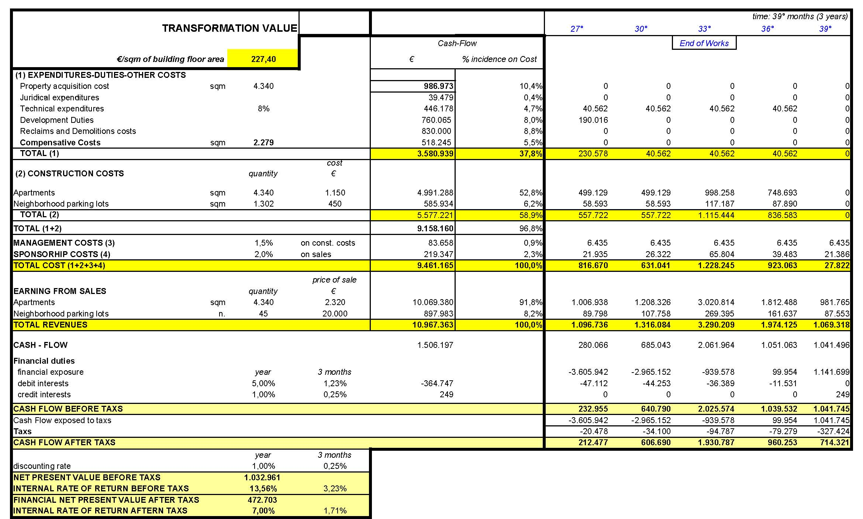
THE POLYTHECNIC OF TURIN CONTRIBUTION
METHODOLOGY PROPOSED AND THE TESTING PROCEDURES
Cost items

Slide 14
THE POLYTHECNIC OF TURIN CONTRIBUTION
METHODOLOGY PROPOSED AND THE TESTING PROCEDURES
The transformation process of each plot leads to a unique outcome, and refers to specific varaibles.
As a consequence the DCF analysis has to be set up on a “case by case” basis, as each Real Estate development involves different items, depending on the following scheme:
LOCATION
i.e.
accessibility of the construction site..
other location
Variables..
LOCATIONS
MARKET VALUE OF THE REAL ESTATE PRODUCT
DESIGN CHOICES
Typology (tower, blocks..)
Technological level
Finishes level
DEVELOPMENT COST

Slide 15
MAIN RESULTS
THE INCIDENCE OF COMPENSATIVE COSTS OF PUBLIC STANDARD SERVICES ON THE PRIVATE DISCOUNTED CASH FLOW ANALYSIS
The proposed methodology has been applied twice on a “case by case” approach, including and excluding the “compensative costs item”, in order to:
Verify the “transformation value” of the plot (without compensative duties)
Calculate the “transformation value” including the compensative costs
Test the % incidence of the added charge on the Developer Cash-Flow
Compare the two amounts and estimate the “negotiation discount”
From the
CASE BY CASE OUTCOME
8% ,10%
-30% ,-35%
% Inc. of the compensative cost on the Total Construction costs
The resulting negotiation discount
To average
VALUES
The added charge causes a % reduction of the final transformation value

Slide 16
CONCLUSIONS
National Jurisdiction private subjects sign up the area requested for public services to the City
TURIN CITY PLAN
If the site (> 4.000 sqm) is not easily available to realize the necessary standards for public services, the private land owner hold the whole plot and has to pay a “compensative cost” to the City, equal to the expropriation allowance
TURIN CITY 2009
The negotiation
The compensative costs are proposed by the private and verified by the City through a Discounted Cash-Flow analysis
EXPROPRIATION ALLOWANCE
(NATIONAL JURISDICTION) before 2008
50% of the market value
EXPROPRIATION ALLOWANCE
(NATIONAL JURISDICTION) since 2008
100% of the market value

Slide 17
CONCLUSIONS
The methodology suggested by the Polytechnic of Turin demonstrates that the negotiation, in comparison with the previous TOP DOWN rule, can even increase the private compensative costs (anyhow below the current expropriation allowance), with an advantage in favor of the Public side, enlarging, at the same time, the private feasibility control on the process.
TURIN CITY 2009
The negotiation
The compensative costs proposed by the private are verified by the City through a Discounted Cash-Flow analysis.
Before 2008
Our average results
After the juridical changing of 2008
100% of the market
price
50% of the market
price
65 - 70% of the market
price
100% of the market
price
8-10% on total costs
THE COMPENSATIVE COST AMOUNT

Slide 18
…2010: the latest news…
8th june 2010
Latest Resolution of the Turin City Counselor for Town Development
It confirms the inefficiency of the 100% expropriation allowance application for the standard areas assessment
It promotes:
In the long term: the arrangements of a discounted values setting, diversified by location (in order to semplify the process)
By now: waiting for the forfait-values setting,the City promotes a -25% discount on the 100% market value of the area. [to be effective from the 22nd june 2010]
(the same discount is provided for expropriation allowances in case of intervenitons of social-economic reform)
The “case by case” DCF analysis has supported the City in defining a fair discount %.

Slide 19
Thank you for your kind attention!
OUR CONTACTS
Prof. Riccardo Roscelli: riccardo.roscelli@polito.it
Arch. Luisa Ingaramo: luisa.ingaramo@polito.it
Arch. Stefania.Sabatino: stefania.sabatino@polito.it

