Slide 1
Carbon dioxide emissions reduction in the housing sector:
Who pays the bill?
Milan, 24th June 2010
Andreas Pfnür, Nikolas Müller, Sonja Weiland

Slide 2
Agenda
Problem
2. Modelling of emission reduction and burden sharing
Results
Conclusion and outlook

Slide 3
Problem
Clean natural environment is a public good
Environmental pollution generates complex external effects
Housing causes 15 % of total CO₂ Emission in Germany
External effects especially carbon dioxide emissions caused by residential heating and air-conditioning have to be internalised
Therefore residents in the European Union are living in a carbon-constrained world (e.g. European Energy Performance of Buildings Directive EPBD)
      Internalisation of the external effects comes at a cost, both politically and economically
      Most common recommendation in environmental economics: polluters pay a fee based on the volume of pollution they create (polluter-pays-principle)
      However, it is not always possible to identify the polluter
      If possible, it is not always economical feasible to refinance investments in order to reduce greenhouse gas emissions
Needed: financial burden-sharing model between owners, occupants and the public
Analysis and data based on housing sector research project conducted within a climate protection commission mandated by the German government
Notes:
I will tell you the highlights of a very intense and 3 men years lasting project, mandated by the german government.
The project was realy hard work because of the competing targets of the different stakeholders involved. The participants where the ministry of transport, building and urban development, the ministery of economics, ministery of finance and the ministery of the environment, Tenant Associations, Landlord Associations, Bank Associations any many others.
It‘s impossible to show all the hundreds of Sread sheets, slides and text pages we produced, to get transperancy into the complex decission informationsbasis.
So I will have to take a short cut and can only present the most interessting results .Much to my regret, this will not be the typical way to present scientific work, because I can not present the complele chain of cause and effect, Anyway, I hope you can think allong the same lines and it is interesting to you.
Tennants can not afford the emission reduction

Slide 4
2 ways of modelling emission reductions in the building sector and burden sharing
Building stock (in Germany)
Deductive approach
Scenario analysis (inductive)
Break down the total (German) building stock in a technical typology
Generate a sample of 25 most representative and demonstrative cases (scenarios)
incorporate ownership and housing market conditions
Create 4 energy efficency clusters (A-D) for one familiy and multi storey dwellings
Define a characteristic/representative improvement case per cluster
Calculate profitability and emission reduction per case
Calculate profitability and emission reduction per case/cluster
Projection
Projection
Forecast emission recuction und burden sharing
(based on status quo)
Notes:
The reason to do 2 ways of modelling was, that one half of the commission did not trust the right side and the other halft did not trust the left side. So we did both to triangulate the empirical results. In the end both models were a good fitting complement.

Slide 5
High technical potential, low volume of efficient projects
41,27 Mt CO₂
Technical emmission reduction potential at average present level
13,39 Mt CO₂
Volume of efficient projects considering
simplified landlord‘s perspective
Therefrom under average conditions profitabile
178,09 Bn €
Volume of efficient projects considering a specific landlord‘s perspective
6,90 Mt CO₂
Incorporate specific market
conditions, ownership specific goals and ownership related cost of capital
124,5 Bn €
Notes:
Round about 60% reduction is possible.
The first and the second bar was calculated on the basis of the before seen left, deductive model.
than we moved from the average to the real case and incorporated the market and ownership related investment conditions. instead of one average case per cluster we get better and worser conditions. The distribution fiunctions are left skewed

Slide 6
From the owners point of view improvements are more than emission reduction investments
Owners standpoint: Improvement is inseperably „one investment“
CO₂-emission reduction investment
„non green“-value enhancement
Resolve maintenance backlog
Is there a chance of profitability? (first DCF-Calculation)
yes 11 of 16 clusters (69%)
no
Return on equity or urban return hurdle rate of individual investor beaten?
yes
no
Is the individual owner able to finance the investment?
yes
no
Verifying Investment 56 %
Refuse Investment
44 %
But: Is elasticity of rental market sufficient and are tenants willing to pay the bill?
Notes:
Landlords are able to apportion max. 11% of the investment costs to the tenants per year

Slide 7


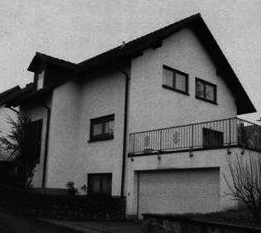
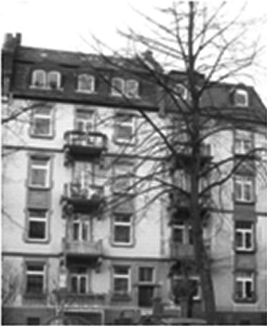

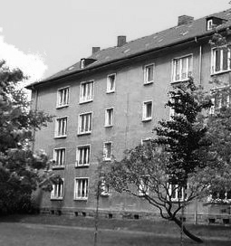
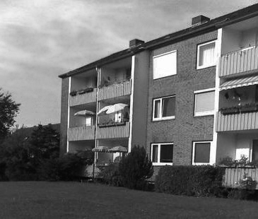
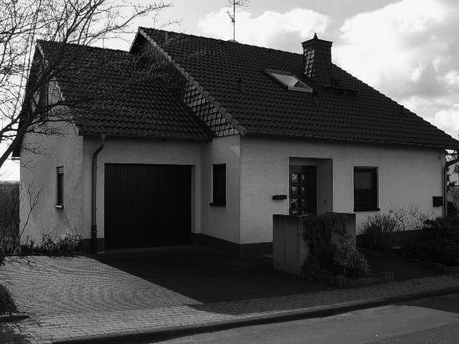
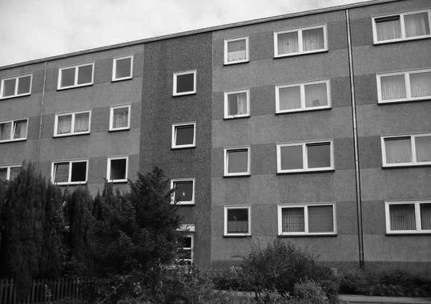
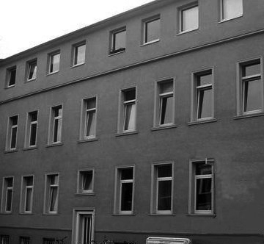
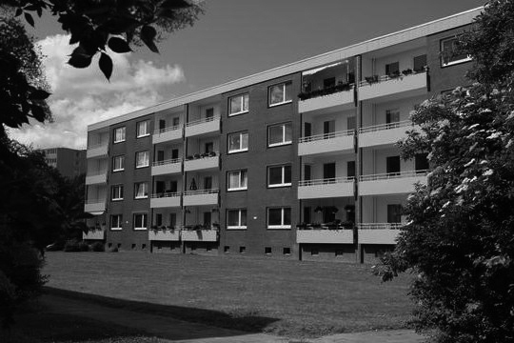
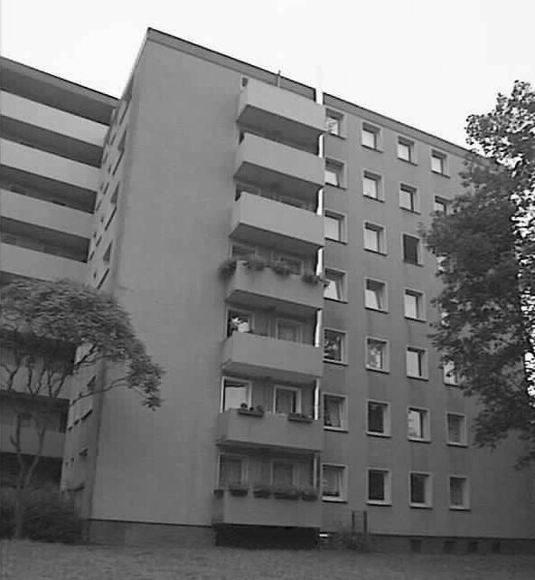
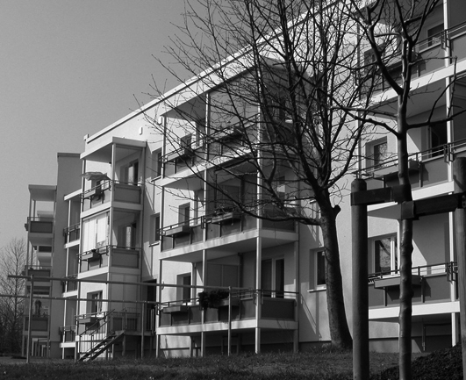
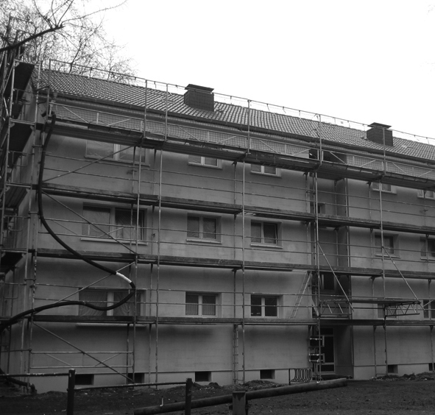
Refinancing investments is the problem: Only a few occupants will / can pay the bill
Scenario-case | Rent increase in % of investment costs | Rent increase in the 1. year in € | Energy cost saving in the 1. year in € | Net. effect rent increase - energy savings
2 | 10 % | 1860,50 | 773,18 | 1087,33
7 | 7 % | 1494,50 | 512,40 | 982,10
8 | 5 % | 3018,75 | 760,73 | 2258,03
9 | 8 % | 1636,80 | 297,60 | 1339,20
10 | 11 % | 3715,25 | 643,84 | 3071,41
14 | 6 % | 1260,72 | 680,00 | 580,72
17 | 7 % | 1400,56 | 483,12 | 917,44
18 | 6 % | 5060,40 | 1725,36 | 3335,04
19 | 8 % | 1768,00 | 331,50 | 1436,50
20 | 7 % | 1593,90 | 342,79 | 1251,11
21 | 3,25 % | 945,00 | 507,00 | 438,00
23 | 5,5 % | 640,43 | 339,01 | 301,42
24 | 7,8 % | 2051,00 | 357,00 | 1694,00
25 | 1,4 % | 52,42 | 702,82 | 650,40
green framed cases: improvement ist efficient

Slide 8
Improvement costs, energy savings and interest rates are most sensitive
Improvement costs
Variation | + 30 % | base case | - 30 %
Efficient cases | 2/25 | 10/25 | 17/25
Average rate of energy price increase (p.a.)
Variation | base case (4 %) | double (8 %) | tripple (12 %)
Efficient cases | 10/25 | 10/25 | 10/25
Energy savings
Variation | - 20 % | base case | + 20 %
Efficient cases | 2/25 | 10/25 | 14/25
Interest rate
Variation | + 1/5 | base case
Efficient cases | 4/25 | 10/25

Slide 9
Implications: Politics has to decide!
21 % CO₂-Emmission reduction between 1995 – 2006 in Germany
  Average improvement rate of building stock was 3 % p.a.
  EU 30%-target for Germany should be achieved until 2020
  More technical potential of 41 Mt p.a. CO₂-Emmission reduction p.a.
„Low hanging Fruits“ probably have been harvested
  General economic hurdles reduce the technical potential of CO₂-Emmission reduction. Remaining investments seldom pay off
  Only selected housing markets can absorb the improvement induced rent increase
  Investor-user-dilemma comes second. Cost of housing dilemma is the key problem to solve
  Somewhere along the road investors will invest of their own accord (e.g. in case of heritage or building wreck off) sometimes also beyond economic criteria
  To bring improvement investments forward can raise potentials, but...
  ... significant increase of cost of housing will bring up significant social problems (rent increase between 1 and 4 Euro facing energy savings between 20 and 70 cent)
  ... enforcing inefficient building investments by authority is against the law, furthermore it is an act of indirect expropriation of the owners
  ... impossible without State subsidies
Notes:
cost of Housing are 33% of disposable income
State subsidies in Germany to be slashed from 1.5 bn Euros to 0.5 bn Euros

Slide 10
Conclusion and Outlook
CO₂-emission reduction in the housing sector is much more an economic problem, then a technical challenge
To tighten Energy Performance of Buildings Directives ignores economic and social reality
  Leads direct into investment backlog
  Retards emission reduction in the housing sector
Owner-occupiers normally are in the best initial position for efficient improvement investments
Sustainable compromise between social, environmental, energy and economic politics is needed
  Good example: local „climate pact“ in German state Schleswig Holstein. Voluntary agreement of refurbishment conditions between all relevant stakeholders

