Slide 1
The role of relative accessibility in urban built environment
Slavomír Ondoš, Shanaka Herath

Slide 2
Overview
Introduction: location in a polycentric urban context
Methods: space syntax and spatial econometrics
Results: distance to CBD vs. network integration
Conclusions

Slide 3
Introduction

Slide 4
Introduction
Location of real estate projects is one of the most important decisions made at the beginning of any development process.
Once a property is constructed, it is attached to the place throughout the whole life cycle and it keeps affecting location of other investments in the neighborhood.
Relative accessibility of the components integrated in the urban structures may explain how potential spatial interactions between them shape the urban pattern.

Slide 5
Introduction
The standard urban model is monocentric.
The principal variable causing variations in constant-quality house prices within a metropolitan area is land price. A typical land rental equation therefore includes distance from the center, agricultural land rental, a conversion parameter that depends on transport cost per distance and community income.
Firms and households are willing to bid more for land that is closer to the center because transport costs will be lower.

Slide 6
Introduction
The controversies between the monocentric and the polycentric nature of cities and their implications for estimation are discussed in the literature.
Dubin (1992), for instance, states that non-CBD peaks in the rent gradient cause traditional means of capturing accessibility effects to give inconclusive results.
These findings direct towards a more flexible means of capturing neighborhood and accessibility effects, which allow for multiple peaks in the rent surface.

Slide 7
Introduction
Spatial interaction models are mathematical formulations used to analyze and forecast spatial interaction patterns.
They are concerned not about the absolute but the relative location.
In the local level, locations are different in a multitude of ways (access to shopping, job opportunities, museums and theatres, rural life-styles, wilderness opportunities, etc). The spatial interaction models measure explicitly such relative location concepts.

Slide 8
Introduction
Space syntax is a collection of topological relative location, accessibility and spatial integration measures (discarding metrics).
First applications have studied the correlation between integration and distribution of pedestrian movements constructed to help architects simulate the likely social effects of their design (Hillier et al. 1983, Hillier and Hanson 1984, Hillier 1988 and 1996).
Subsequently it was used in urban studies and regional science (Brown 1999, Kim and Sohn 2002, Enström and Netzell 2008).

Slide 9
Introduction
We examine the relationship between relative accessibility and built environment density in Bratislava, Slovak Republic, with its emerging post-socialist real estate market between the years 1991 and 2006.
Question 1: The better integrated locations are more attractive subject to competition resulting in a higher built environment density.
Question 2: The transition period documents a process of density gradient restoration driven significantly by the relative accessibility.

Slide 10
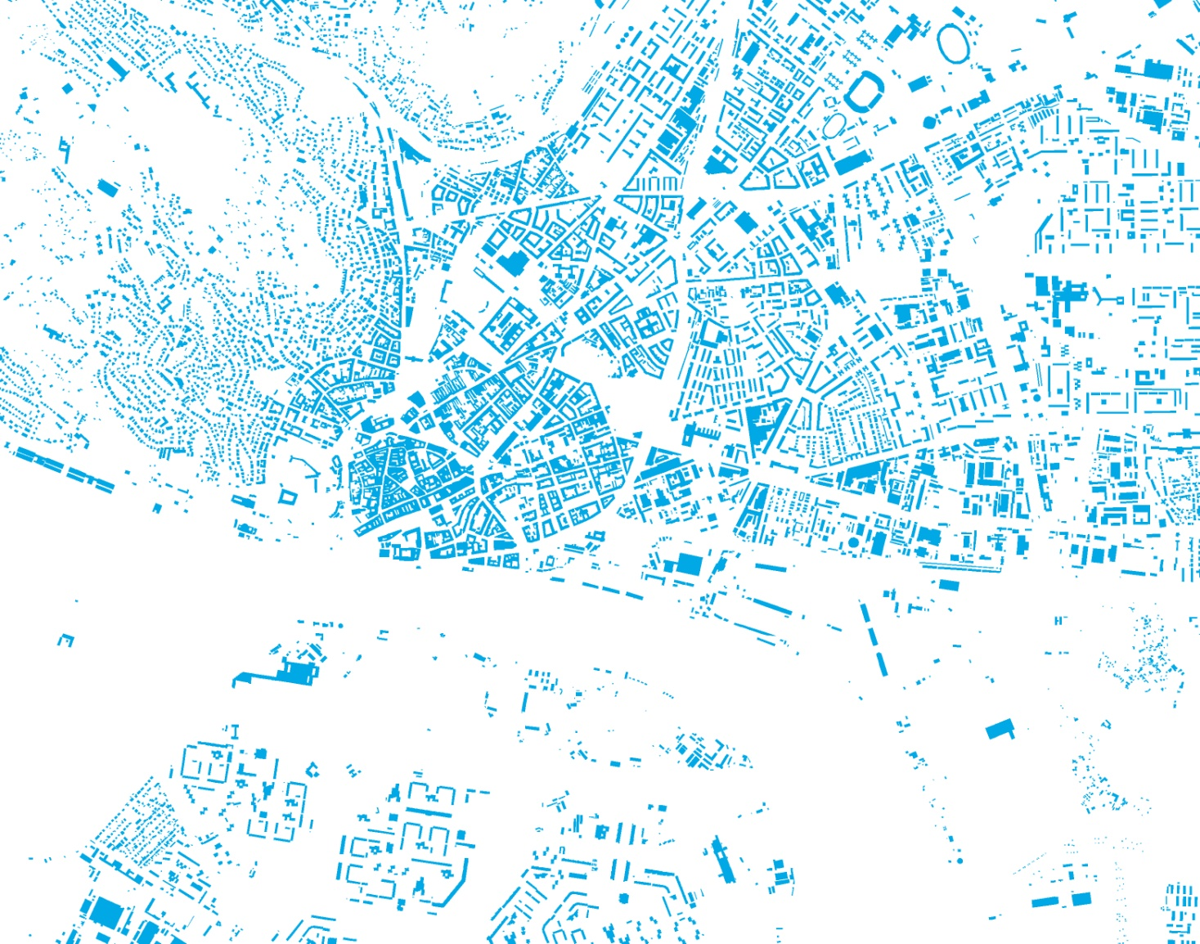
Central Bratislava, 1991 in vector

Slide 11

Central Bratislava, 1991 in 100 m raster
0.00 - 0.50
0.50 – 0.15
0.15 – 0.30
0.30 – 0.60
0.60 – 100.00

Slide 12

Central Bratislava, 2006 in 100 m raster
0.00 - 0.50
0.50 – 0.15
0.15 – 0.30
0.30 – 0.60
0.60 – 100.00

Slide 13
Methods and data

Slide 14
Methods
Approaching directly our research questions we construct three regression models explaining built environment density measured on urban topography in both time horizons as well as the difference during the 15 years between
D₁₉₉₁ = α + βx + ε
D₂₀₀₆ = α + βx + ε
ΔD₁₉₉₁₋₂₀₀₆ = α + βΔx + ε
Two explanatory variables will be considered

Slide 15
Methods
Distance DIS₁₉₉₁₍₂₀₀₆₎ captures the effect from Euclidean distance between the cell and the gravity point having its coordinates as mean values from total cellular space. The weights used are D₁₉₉₁ and D₂₀₀₆.
Integration INT₁₉₉₁₍₂₀₀₆₎ quantifies average global integration resulting from the position of a cell in the street network transformed into an axial system used by the space syntax methodology.

Slide 16
Methods
Mean depth mD_{i} = D_{i} / (L-1) indicates how close is an average axial line to all other axial lines in the system if d_{ij} is topological distance
D_{i} = Σ^{L-1}_{j=1, j≠i} d_{ij}
Relative asymmetry in the empirical system is then compared with the diamond-shaped street network system resulting in the standardized value of integration (Enström and Netzell 2008)
RA_{i} = 2(mD_{i} – 1) / (L–2)
INT = RA_{D}/RA_{i}

Slide 17
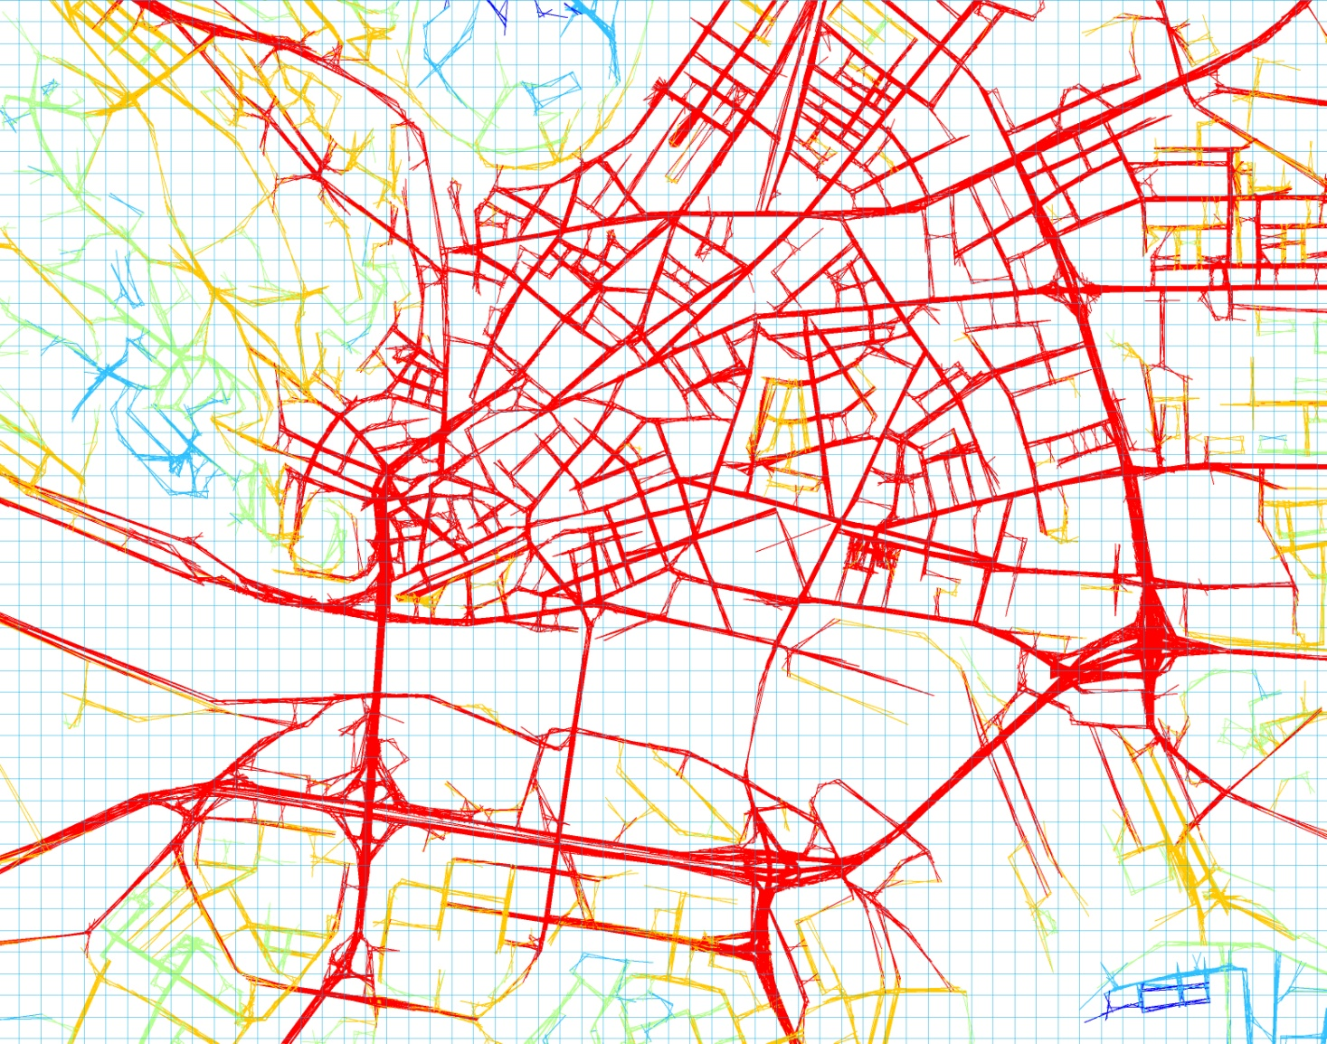
Central Bratislava, 2006 street network integration
0.49 - 0.76
0.76 – 0.90
0.90 – 1.03
1.03 – 1.17
1.17 – 1.45

Slide 18
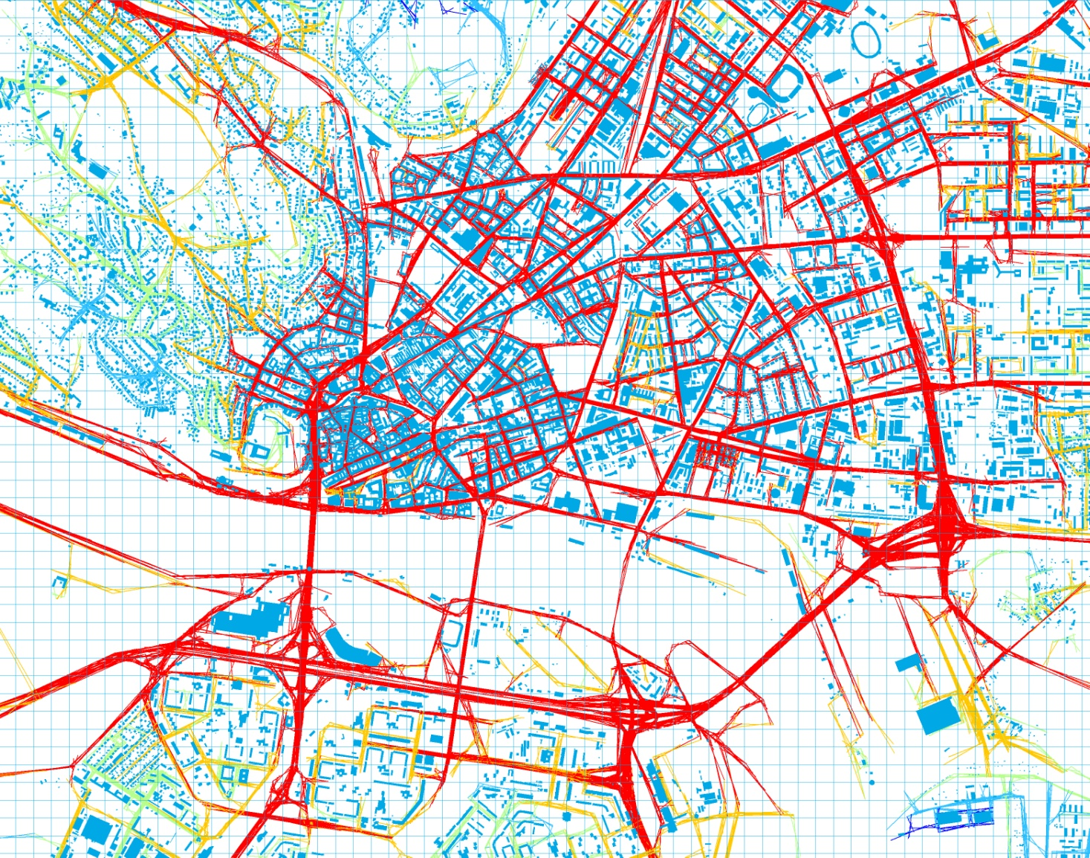
Central Bratislava, 2006 street network integration
0.49 - 0.76
0.76 – 0.90
0.90 – 1.03
1.03 – 1.17
1.17 – 1.45

Slide 19
Methods
Since the three constructed models will necessarily incorporate spatial effects (from vector → raster data transformation, spatial interaction within the urban system), we must provide regression diagnostics and diagnostics for spatial dependence.
Two alternative estimations considered will be the spatial lag model and the spatial error model
D = α + ρWD + βx + ε
D = α + βx + ε, ε = λWε + ζ

Slide 20
Results

Slide 21
Results D₁₉₉₁
R² (OLS) | 0,13
JB | 518323,60 | 0,00
BP | 6335,60 | 0,00
KB | 666,94 | 0,00
Moran`s I | 0,60 | 0,00
LM_{ρ} | 54,09 | 0,00
LM_{λ} | 59,58 | 0,00
R² (LAG) | 0,66
R² (ERR) | 0,66
R² (OLS) | 0,20
JB | 768048,60 | 0,00
BP | 13908,83 | 0,00
KB | 1206,32 | 0,00
Moran`s I | 0,48 | 0,00
LM_{ρ} | 4886,62 | 0,00
LM_{λ} | 204,35 | 0,00
R² (LAG) | 0,66
R² (ERR) | 0,66
R² (OLS) | 0,23
JB | 757528,20 | 0,00
BP | 14758,21 | 0,00
KB | 1286,32 | 0,00
Moran`s I | 0,50 | 0,00
LM_{ρ} | 3951,05 | 0,00
LM_{λ} | 2,98 | 0,08
R² (LAG) | 0,66
R² (ERR) | 0,66
Variable | Coefficient | Std. Error | z-value | Probability
CONSTANT | 1079,04 | 44,51 | 24,24 | 0,00
DIS₁₉₉₁ | -0,09 | 0,00 | -17,58 | 0,00
λ | 0,85 | 0,00 | 238,70 | 0,00
Variable | Coefficient | Std. Error | z-value | Probability
ρ | 0,84 | 0,00 | 229,50 | 0,00
CONSTANT | 8,98 | 3,50 | 2,57 | 0,01
INT₁₉₉₁ | 151,74 | 6,69 | 22,67 | 0,00
Variable | Coefficient | Std. Error | z-value | Probability
ρ | 0,84 | 0,00 | 220,71 | 0,00
CONSTANT | 76,46 | 9,41 | 8,12 | 0,00
DIS₁₉₉₁ | -0,01 | 0,00 | -7,83 | 0,00
INT₁₉₉₁ | 124,74 | 7,56 | 16,50 | 0,00

Slide 22
Results D₂₀₀₆
R² (OLS) | 0,12
JB | 672774,70 | 0,00
BP | 3635,20 | 0,00
KB | 337,04 | 0,00
Moran`s I | 0,62 | 0,00
LM_{ρ} | 54,80 | 0,00
LM_{λ} | 60,13 | 0,00
R² (LAG) | 0,66
R² (ERR) | 0,66
R² (OLS) | 0,19
JB | 890196,90 | 0,00
BP | 10276,62 | 0,00
KB | 830,00 | 0,00
Moran`s I | 0,50 | 0,00
LM_{ρ} | 4622,01 | 0,00
LM_{λ} | 266,12 | 0,00
R² (LAG) | 0,66
R² (ERR) | 0,66
R² (OLS) | 0,21
JB | 950674,60 | 0,00
BP | 10280,29 | 0,00
KB | 803,34 | 0,00
Moran`s I | 0,52 | 0,00
LM_{ρ} | 3748,73 | 0,00
LM_{λ} | 21,06 | 0,00
R² (LAG) | 0,66
R² (ERR) | 0,66
Variable | Coefficient | Std. Error | z-value | Probability
CONSTANT | 1179,37 | 50,53 | 23,34 | 0,00
DIS₂₀₀₆ | -0,09 | 0,01 | -16,41 | 0,00
λ | 0,86 | 0,00 | 244,48 | 0,00
Variable | Coefficient | Std. Error | z-value | Probability
ρ | 0,85 | 0,00 | 235,11 | 0,00
CONSTANT | 10,92 | 3,95 | 2,77 | 0,01
INT₂₀₀₆ | 148,75 | 6,93 | 21,46 | 0,00
Variable | Coefficient | Std. Error | z-value | Probability
ρ | 0,84 | 0,00 | 226,98 | 0,00
CONSTANT | 81,50 | 10,27 | 7,94 | 0,00
DIS₂₀₀₆ | -0,01 | 0,00 | -7,56 | 0,00
INT₂₀₀₆ | 123,07 | 7,75 | 15,88 | 0,00

Slide 23
Results ΔD₁₉₉₁₋₂₀₀₆
R² (OLS) | 0,00
JB | 54419540,00 | 0,00
BP | 266,62 | 0,00
KB | 2,84 | 0,09
Moran`s I | 0,42 | 0,00
LM_{ρ} | 0,00 | 0,96
LM_{λ} | 0,00 | 0,98
R² (LAG) | 0,41
R² (ERR) | 0,41
R² (OLS) | 0,02
JB | 53398210,00 | 0,00
BP | 39202,81 | 0,00
KB | 422,10 | 0,00
Moran`s I | 0,40 | 0,00
LM_{ρ} | 473,80 | 0,00
LM_{λ} | 2,03 | 0,15
R² (LAG) | 0,42
R² (ERR) | 0,42
R² (OLS) | 0,02
JB | 53151240,00 | 0,00
BP | 40306,13 | 0,00
KB | 434,98 | 0,00
Moran`s I | 0,40 | 0,00
LM_{ρ} | 489,65 | 0,00
LM_{λ} | 1,46 | 0,23
R² (LAG) | 0,42
R² (ERR) | 0,42
Variable | Coefficient | Std. Error | z-value | Probability
ρ | 0,77 | 0,00 | 162,96 | 0,00
CONSTANT | 5,98 | 1,84 | 3,24 | 0,00
ΔINT₁₉₉₁₋₂₀₀₆ | 189,05 | 11,83 | 15,99 | 0,00
Variable | Coefficient | Std. Error | z-value | Probability
ρ | 0,76 | 0,00 | 162,76 | 0,00
CONSTANT | 6,10 | 1,84 | 3,30 | 0,00
ΔDIS₁₉₉₁₋₂₀₀₆ | -0,02 | 0,01 | -2,16 | 0,03
ΔINT₁₉₉₁₋₂₀₀₆ | 190,28 | 11,84 | 16,08 | 0,00

Slide 24
Results ΔD₁₉₉₁₋₂₀₀₆ (alternative)
R² (OLS) | 0,00
JB | 55398360,00 | 0,00
BP | 772,57 | 0,00
KB | 8,17 | 0,02
Moran`s I | 0,42 | 0,00
LM_{ρ} | 686,14 | 0,00
LM_{λ} | 936,87 | 0,00
R² (LAG) | 0,42
R² (ERR) | 0,43
R² (OLS) | 0,01
JB | 56176920,00 | 0,00
BP | 1576,48 | 0,00
KB | 16,56 | 0,00
Moran`s I | 0,42 | 0,00
LM_{ρ} | 34,66 | 0,00
LM_{λ} | 44,12 | 0,00
R² (LAG) | 0,42
R² (ERR) | 0,43
R² (OLS) | 0,01
JB | 56362850,00 | 0,00
BP | 1798,72 | 0,00
KB | 18,86 | 0,00
Moran`s I | 0,42 | 0,00
LM_{ρ} | 0,59 | 0,44
LM_{λ} | 100,31 | 0,00
R² (LAG) | 0,42
R² (ERR) | 0,43
Variable | Coefficient | Std. Error | z-value | Probability
CONSTANT | 207,85 | 19,87 | 10,46 | 0,00
URB₁₉₉₁ | -0,09 | 0,00 | -28,28 | 0,00
DIS₁₉₉₁ | -0,01 | 0,00 | -6,44 | 0,00
λ | 0,79 | 0,00 | 175,54 | 0,00
Variable | Coefficient | Std. Error | z-value | Probability
CONSTANT | 96,73 | 8,70 | 11,12 | 0,00
URB₁₉₉₁ | -0,09 | 0,00 | -27,67 | 0,00
INT₁₉₉₁ | -16,34 | 6,88 | -2,37 | 0,02
λ | 0,79 | 0,00 | 178,85 | 0,00
Variable | Coefficient | Std. Error | z-value | Probability
CONSTANT | 227,72 | 20,78 | 10,96 | 0,00
URB₁₉₉₁ | -0,09 | 0,00 | -28,25 | 0,00
DIS₁₉₉₁ | -0,02 | 0,00 | -6,94 | 0,00
INT₁₉₉₁ | -24,53 | 6,99 | -3,51 | 0,00
λ | 0,79 | 0,00 | 176,66 | 0,00

Slide 25
Model selection
 | AIC | Schwarz
DIS₁₉₉₁ | 581304 | 581321
INT₁₉₉₁ | 581122 | 581148
DIS₁₉₉₁, INT₁₉₉₁ | 581059 | 581093
DIS₂₀₀₆ | 588692 | 588709
INT₂₀₀₆ | 588524 | 588549
DIS₂₀₀₆, INT₂₀₀₆ | 588466 | 588500
ΔDIS₁₉₉₁₋₂₀₀₆
ΔINT₁₉₉₁₋₂₀₀₆ | 547458 | 547484
ΔDIS₁₉₉₁₋₂₀₀₆, ΔINT₁₉₉₁₋₂₀₀₆ | 547455 | 547489
DIS₂₀₀₆ | 546919 | 546944
INT₂₀₀₆ | 546954 | 546980
DIS₂₀₀₆, INT₂₀₀₆ | 546909 | 546943
ΔLL = 32,000, Δdf = 1 (> 3,841, α = 0,05)
ΔLL = 30,000, Δdf = 1 (> 3,841, α = 0,05)
ΔLL = 2,000, Δdf = 1 (< 3,841, α = 0,05)
ΔLL = 23,826, Δdf = 1 (> 3,841, α = 0,05)

Slide 26
Conclusions

Slide 27
Conclusions
Question 1: The better integrated locations are more attractive subject to competition resulting in higher built environment density.
The more intensively urbanized locations are those better integrated within the street network and these are also closer to the gravity point (negative effect from distance).
This regularity is found in both 1991 and 2006 with an identical effect from distance and slightly decreasing effect from integration.

Slide 28
Conclusions
Question 2: The transition period documents a process of density gradient restoration driven significantly by relative accessibility.
The locations with improved integration and approaching the flowing center have been significantly more urbanized during the 15 years than those which became less integrated.
The negative effect from distance to gravity point is found significant only in presence of integration explanatory variable. The model attempting to explain it by distance alone has a serious specification problem.

Slide 29
Conclusions
Question 2: The transition period documents a process of density gradient restoration driven significantly by relative accessibility.
Significantly more urbanized during the same period were those locations with lower integration value, closer to the center and less urbanized in 1991.
The negative effects from distance to gravity point, integration and urbanization level in 1991 are found significant in all three cases correctly specified as spatial error models.

Slide 30
Conclusions
Parameter values identifying spatial effects in both alternative models ρ and λ are positive and significant without any exception.
Locations tend to be more intensively urbanized if they have more urbanized neighborhood in compare to those with less intensively urbanized neighborhood.
The models explaining density by distance alone are driven towards the spatial error alternative. The models explaining density by integration are driven towards theoretically superior spatial lag alternative (except the 4th alternative).

Slide 31
Forschungsinstitut für Raum-
und Immobilienwirtschaft
Research Institute for Spatial and
Real Estate Economics
Nordbergstraße 15, 1090 Vienna, Austria
MGR. SLAVOMÍR ONDOŠ
T +43-1-313 36-5764
F +43-1-313 36-705
slavomir.ondos@wu-wien.ac.at
www.wu.ac.at/immobilienwirtschaft

